Slide 1
CAPSTONE PROJECT (LOAN DATA)
CHECKPOINT 1
BY BATCH I GROUP 5

Slide 2
1. Shubhaditya Dutta
2. Narayani Patil
3. Chinmay Raut
4. Jayanth Marisetty
5. Rimjhim Gupta
GROUP MEMBERS

Slide 3
TEAM MEMBER RESPONSIBILITIES
Based on our team composition, Shubhaditya had prior experience with Python. Rimjhim, Narayani and Jayanth had prior experience with SQL in college projects and accordingly we had divided our task. We still collaborated in every task as a team.
Task 1.1 : Shubhaditya, Narayani, Rimjhim, Jayanth
Task 1.2 : Narayani, Rimjhim
Auxiliary Helpers-Shubhaditya, Jayanth
Task 1.3 : Chinmay, Shubhaditya

Slide 4
Task 1.1 Data Manipulation using Python
Problem Statement-
Analysis of percentage of default and check whether it is imbalanced data?
Replace missing values with appropriate techniques.
Use the right treatment for outliers in the data.
Analyse default variable with demographic related data.
Determine and draw insights on association between default and other variables, both categorical and numerical.

Slide 5
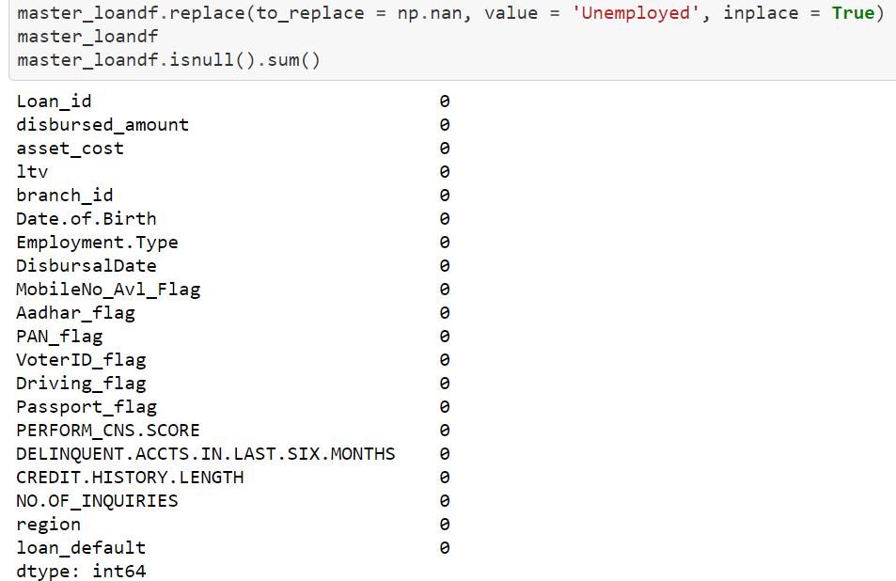
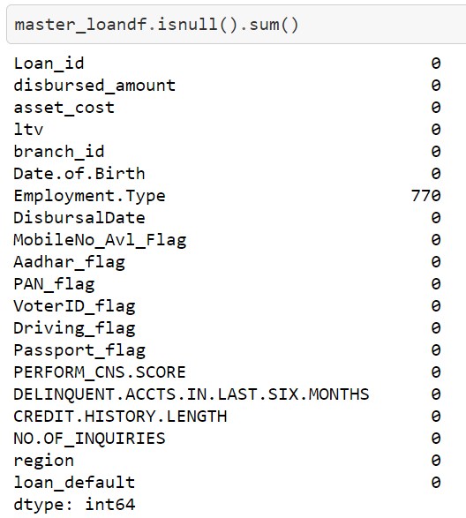
Step 1: Load the given datasets in Jupyter Notebook.
Step 2: Combine the subsidiary data to form a master dataframe.
Step 3: Find the missing values.
Our dataset had 770 missing values for Employment.Type. We assumed that these missing values are unemployed.
Approach to solution

Slide 6
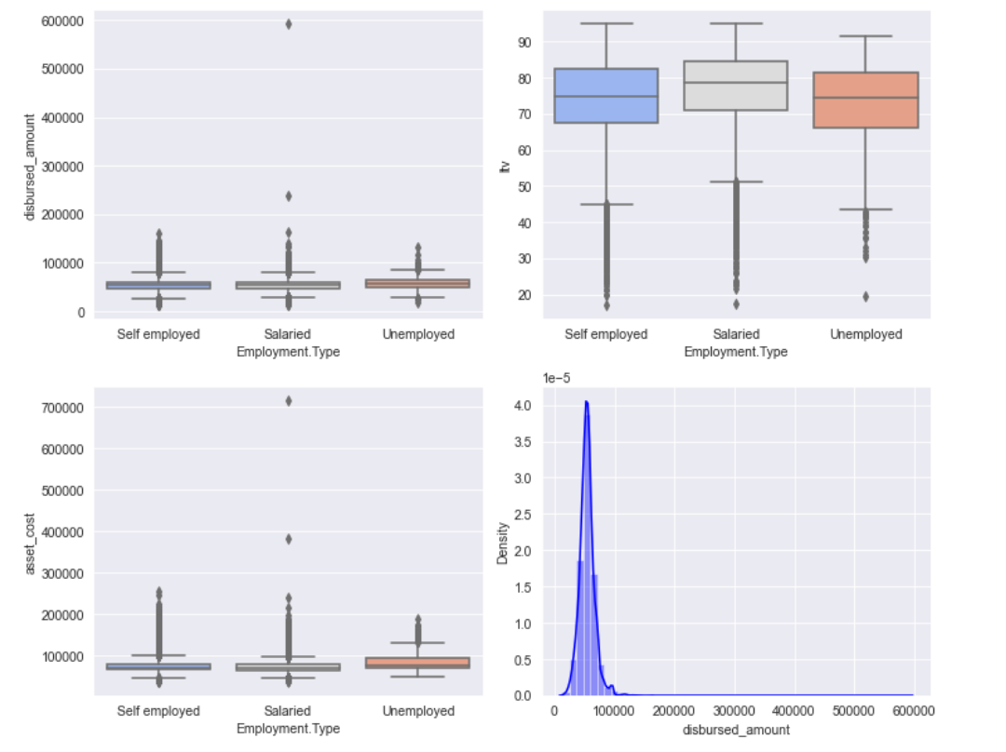
Step 4: Detect the outliers and treat the dataset for outliers.
In our dataset, any disbursed_amount value which is above 99.99th quantile will be capped at 99.99th quantile while any value below 1st quantile will be capped at 1st quantile. This sets the upper and lower limits for outliers.
Step 5: Age has been calculated to analyze the demographic distribution.
Step 6: Assess the data based on default status.
It suggested that nearly 22% of the given data belongs to default category and rest of the data belongs to the non-default category. It may lead to majority oversampling if the whole dataset is considered for training the model.

Slide 7
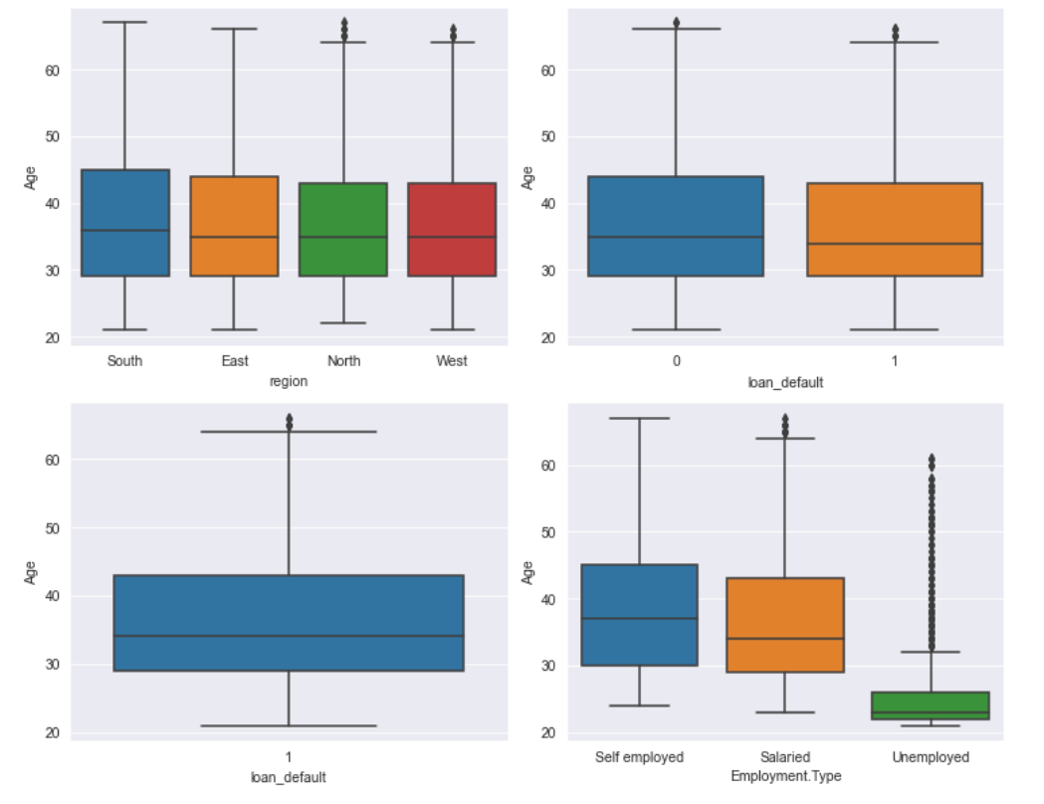
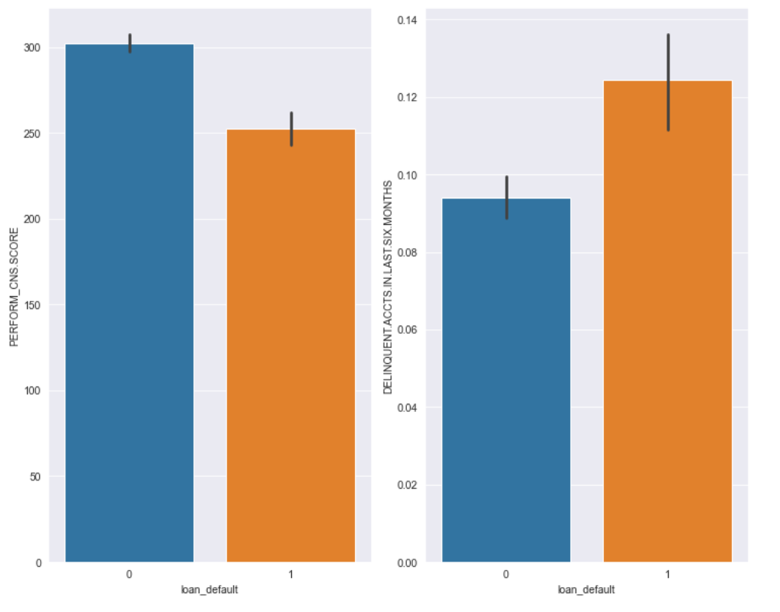
Step 7: Analyze the dataset based on categorical data like 'Region’, 'Employment Type’, 'CNS Score' and 'Delinquent Account count’.

Slide 8
CCOCC
CONCLUSION
From the analysis, we can conclude the following-
1. P.s. Assumption - Post the analysis of Age distribution between different Employment types, it is observed that the Unemployment type (earlier replaced with this label as a part of missing value treatment) belongs to a lower age group which further confirms the label chosen, lower age group might yet to be Employed and forms the Educational loan portfolio of the bank.
2. The young population (20-30 years of age) is majorly unemployed and are more susceptible to default.
3. The customers with lower bureau score and high delinquent accounts are more susceptible to default.
4. The given data is imbalanced with 22% default data-points. To train the model we have more non default data-points but less default ones so the model might not be good at predicting defaults and might give false negatives or type 2 error.

Slide 9
Task 1.2 SQL - Oracle
Stage 1:
Construct and ER-Diagram for the above-mentioned Requirement
Construct Tables has per the ER-Diagram.
Identify the relationships between tables and use appropriate standards for the same where applicable
Insert the appropriate data into the identified tables from the sample dataset provided.
Stage 2:
Generate Reports of the customer who has approached for the loan and all kyc is submitted and disbursal date is not given, or loan is not disbursed.
Generate Reports of the customer who has approached for the loan whose Bureau Score is less than 650 and min. enquires made is >3 and the cost of asset is between 50000 to 70000 and ltv is between the range of 50-60.
Generate Reports of the customer who has approached for the loan whose Bureau Score is less than 650 and min. enquires made is >3 and the cost of asset is between 50000 to 70000 and ltv is between the range of 50-60.
Generate Reports of the self-employed customer who has approached for the loan whose Bureau Score is less than 650 and min. enquires made is >3 and loan default are 0 and and if all kyc is submitted and cross checked if any dues to previous loans.
Generate Reports of those customers where the loan is disbursed based on the Cibil score ranging between 670 -780 and also who are acquired the loan for more then 1 time and loan default is 1 or 0.

Slide 10
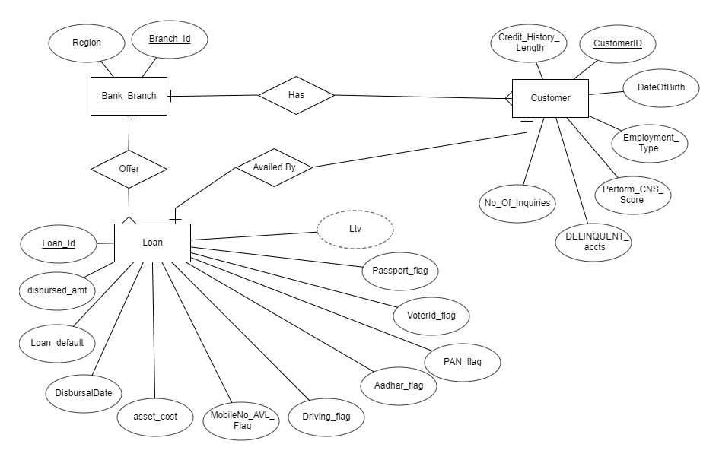
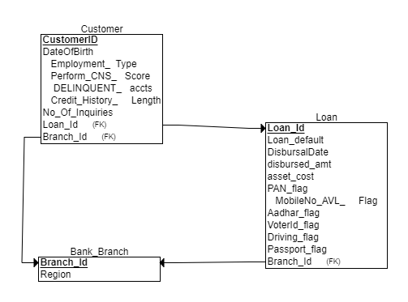
Task 1.2- Stage 1
ER Diagram
Tables as per ER diagram
Loan(Loan_Id, Loan_default, DisbursalDate, disbursed_amt, asset_cost, PAN_flag, MobileNo_AVL_Flag, Aadhar_flag, VoterId_flag, Driving_flag, Passport_flag)
Customer(CustomerID, DateOfBirth, Employment_Type, Perform_CNS_Score, DELINQUENT_accts, Credit_History_Length, No_Of_Inquiries)
Bank_Branch (Branch_id, Region)

Slide 11
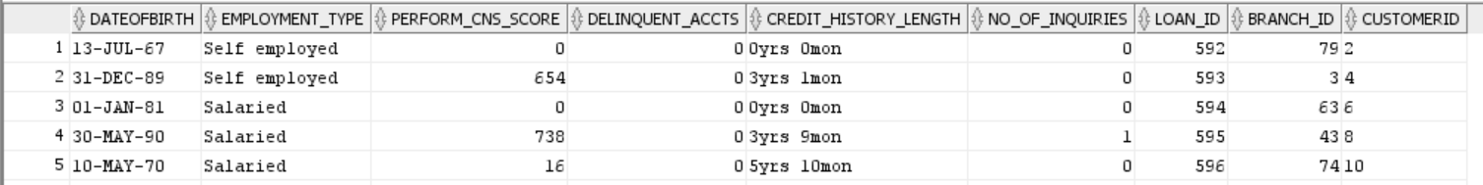
Task 1.2- Stage 2 (Performed SQL Queries)
Assumption-Mandatory KYC documents for business loans are Aadhar card and PAN card (Mobile number already
linked with Aadhar card) but due to no such records found with respect to the given queries, it has been assumed
that mobile number is mandatory KYC document along with any one of the other five documents.
Since the primary key for customer table is not given so we have generated a sequence to uniquely identify
the customers.
The query for the same is given below-
ALTER TABLE CUSTOMER ADD CustomerId VARCHAR(10);
CREATE SEQUENCE cust_id_seq START WITH 2
INCREMENT BY 2
MAXVALUE 99999999
MINVALUE 1
NOCYCLE;
UPDATE CUSTOMER SET CustomerId = cust_id_seq.NEXTVAL;
SELECT * FROM CUSTOMER;
This query adds a column CustomerId with unique values to the existing data to identify the customers.

Slide 12
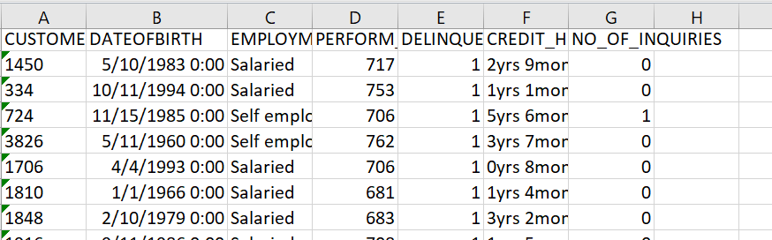
In the SQL queries we have generated customer reports for various conditions such as whether all KYC is done or not, Bureau Score is less than 650 and min. inquires made is >3 and the cost of asset is between 50000 to 70000 and LTV is between the range of 50-60, loan default are 0 , who are acquired the loan for more than 1 time .
Generate Reports of those customers where the loan is disbursed based on the Cibil score ranging between 670 -780 and also who are acquired the loan for more than 1 time and loan default is 1 or 0.
The above query returns 265 records which meet the above stated requirements. Cibil score in the range of 670- 780 is considered good for the approval of loans. The output includes the defaulters as well as non- defaulters.
Output for above discussed query ->

Slide 13
Task 1.3
Statistical Analysis using Python
Problem Statement-
Descriptive statistics for both numerical and categorical and draw few insights from them.
Perform relevant hypothesis testing (t, chi-Square, Anova tests)

Slide 14
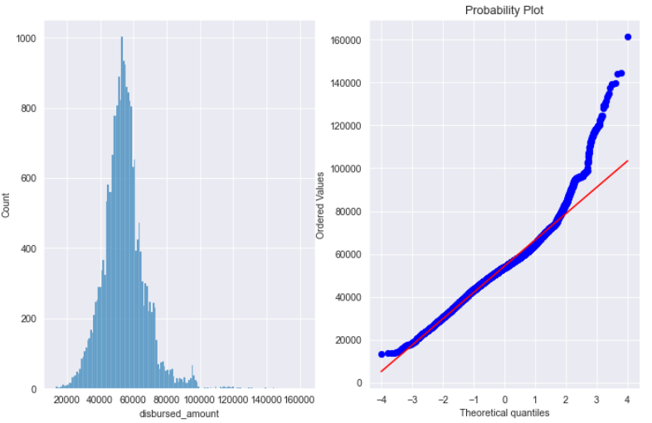
Approach to Solution
Step 1 : Plot histogram to understand loan amount distribution.
From this visualization it is evident that the loan amount distribution is normal with a positive skew shown in both hist plot and Q-Q plot(the higher values shows higher variance). This is may be due to the loan base is being comprised of more than one group of people that is based on employment type.
To analyze the variance within the population contributed by different groups we need to conduct an ANOVA test otherwise if it were only 1 group a z test would have been sufficient.

Slide 15
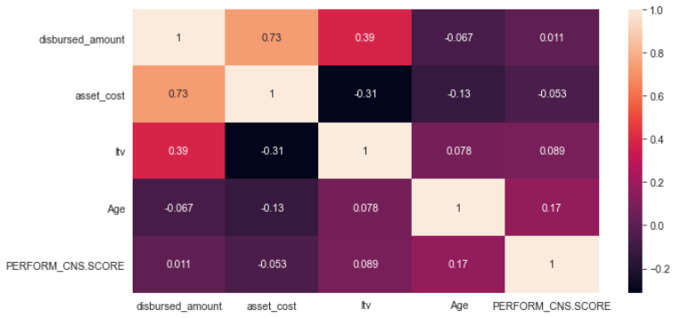
Step 2 : Find the correlation among the loan attributes.
From this we chose Loan Disbursement Amount as our primary feature for variance analysis as it shows higher correlation with most of the other numerical features.
Also, the disbursement amount is dependent amount is dependent on asset cost and loan to value ratio excluding loan charges in reality, hence will capture the linear relationship between all these features.
Step 3 : Attempting to infer the mean of disbursed loan amount based on Employment type, that is if the loan amount is significantly different among different groups.

Slide 16
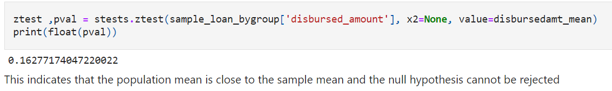
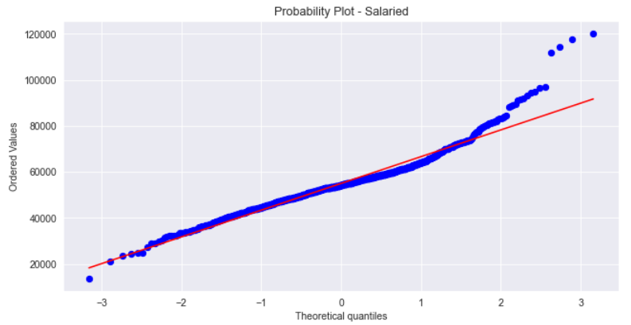
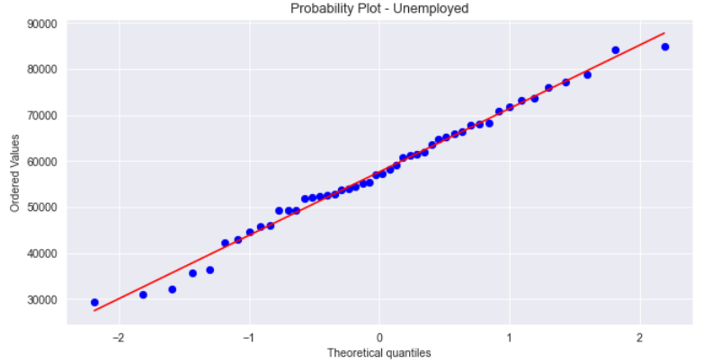
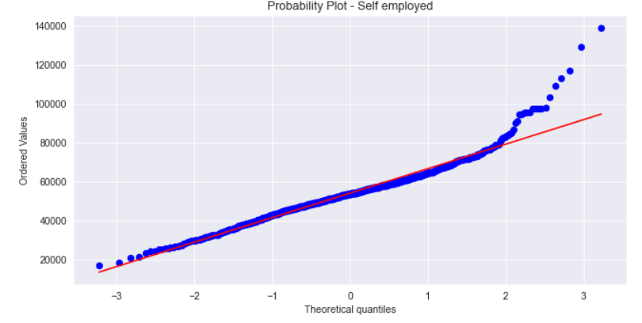
Step 4 : Hypothesis Testing
Hypothesis Testing to determine if the chosen sample represents the whole population H₀: μ₁= x_bar (population mean of disbursed amounts and the sample mean are equal) H₁: μ₁!=x_bar (population mean of disbursed amounts and the sample mean are not equal) α = 0.05.

Slide 17
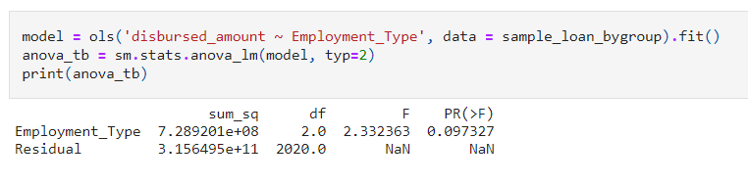
Step 4 : Hypothesis Testing
Step 5 : By plotting Probability plot, it is observed that the sample loan amount distribution based on each employment type is normal.
Hypothesis Testing H₀: μ₁= μ₂ = μ₃ (mean of disbursed amounts as per employment within the population are equal) H₁: Not all disbursed amount means as per category are equal α = 0.05.
Step 6 : Conducting ANOVA Test
Using regression of loan_amount of the whole sample on loan amount with different employment types.
Result : From the above, applying p value approach we can say that p_value> significance of 0.05 and the null hypothesis cannot be rejected. So, we conclude that various employment type do not contribute to insample variance. The loan amount is evenly distributed between different groups (between group ANOVA test). Similar conclusion is confirmed by a Boxplot in the prior section. We also conclude that the sample shows within group variance rather than between group variance.

Slide 18
Thank You

